Slide 1
FINA4380
Supplementary Notes

Slide 2
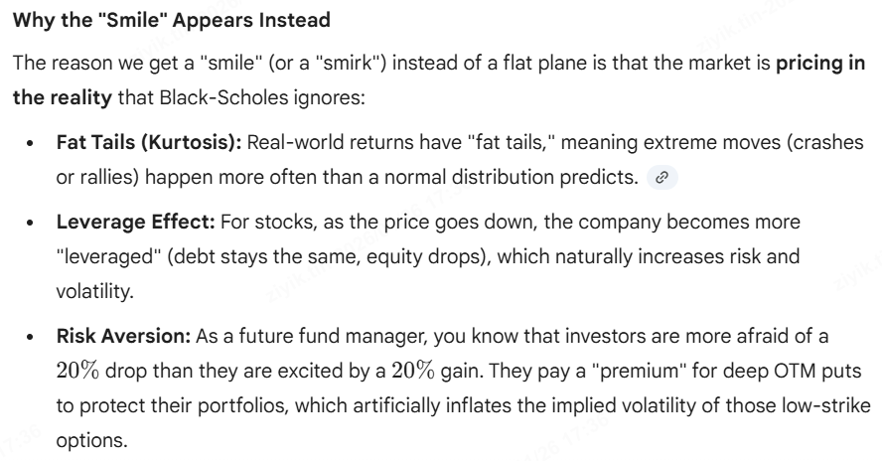
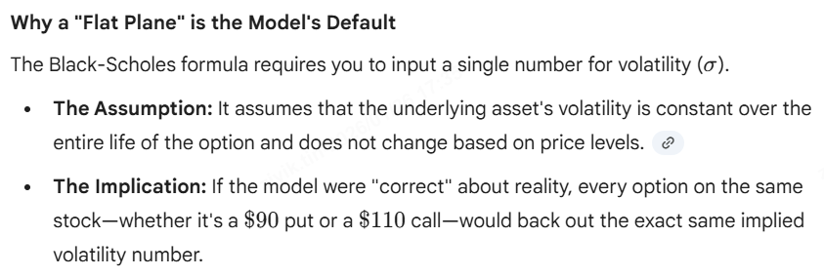



Risk-Neutrality of Black Scholes Model
Risk-neutral = drift becomes risk-free rate

Slide 3
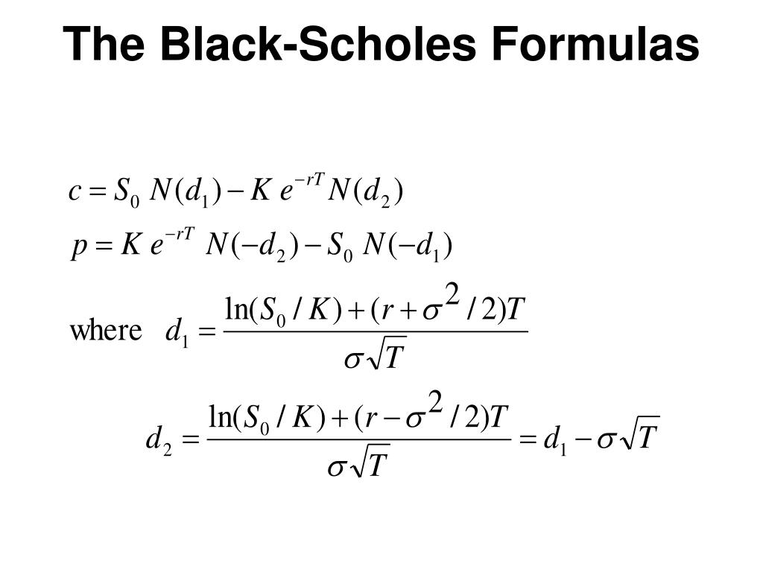
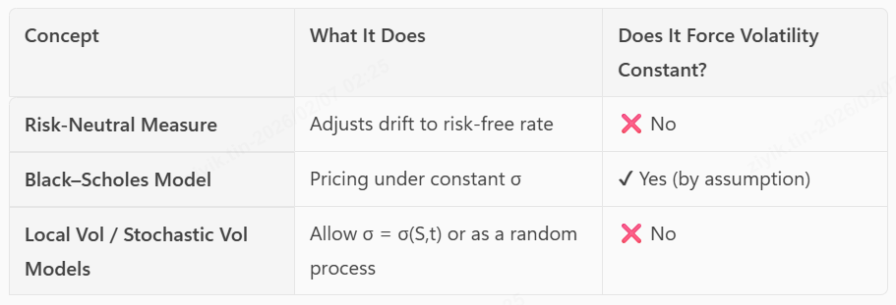
It’s BS that force constant vol, not because of risk neutral

Slide 4
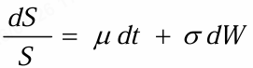
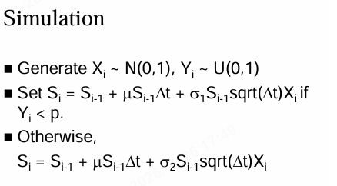
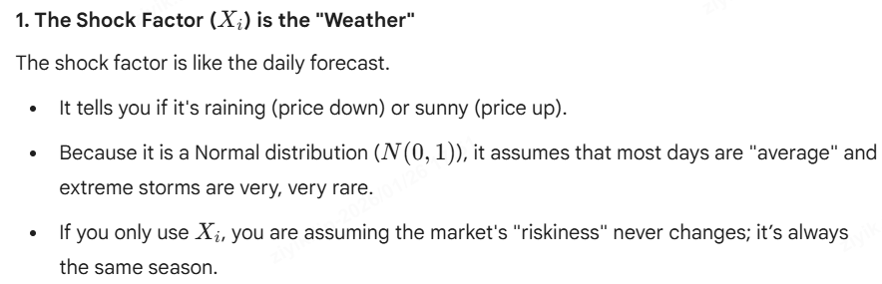
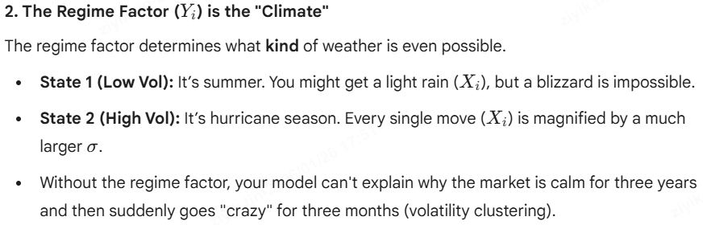
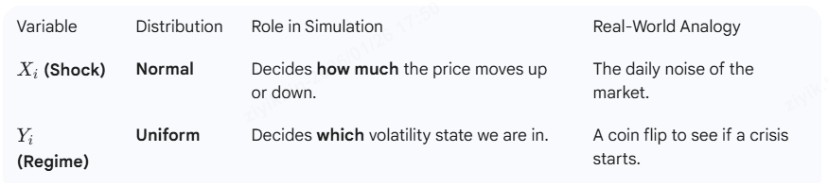

Random Volatility Model

Slide 5
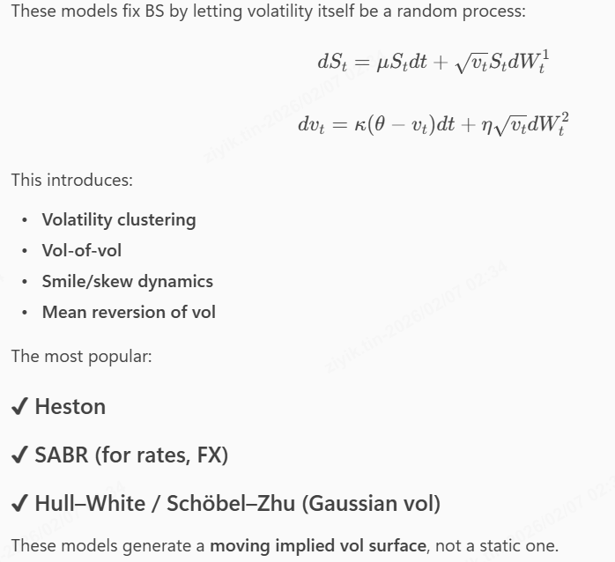
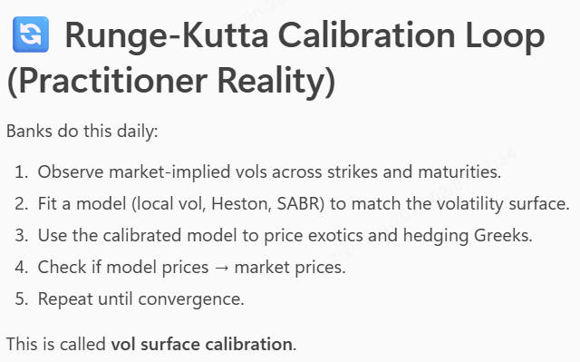
Stochastic Volatility Model
After you pull market vol data, you choose a model → guess parameters → compute model implied vols → compare to market implied vols → adjust parameters → iterate until both match.

Slide 6
ORDER FLOW
Supplementary Notes

Slide 7
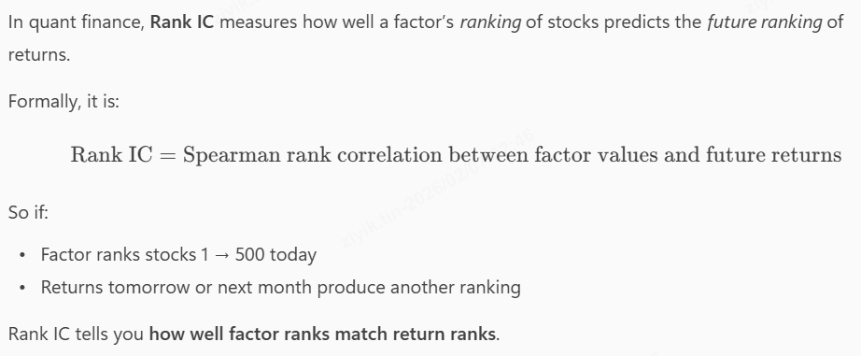
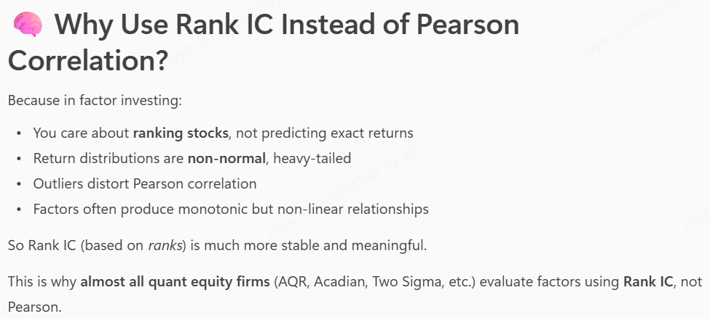
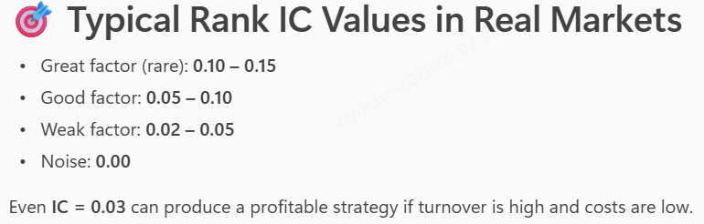
Rank Information Coefficient
RankIC tells you how well today's order flow imbalances predict tomorrow’s (or next 5 minutes’) cross-sectional returns.

Slide 8
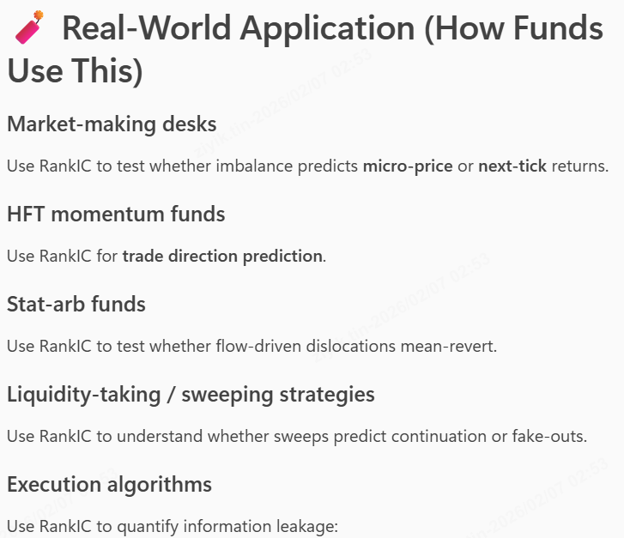
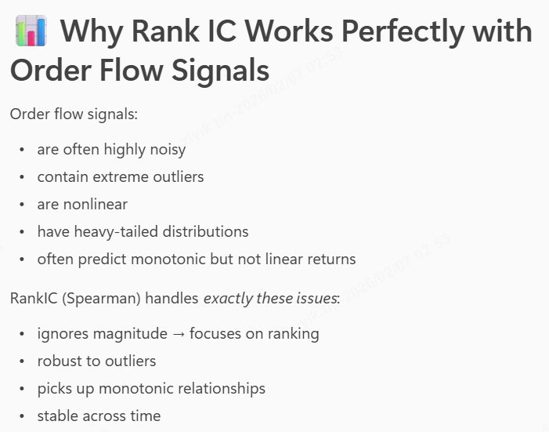
Rank Information Coefficient

Slide 9
Order Flow Factors
net buying pressure
order imbalance
aggressive vs passive flow
liquidity provision/withdrawal
volume‑synchronized price moves
VPIN / toxicity
market maker inventory pressure
large trader footprints

Slide 10
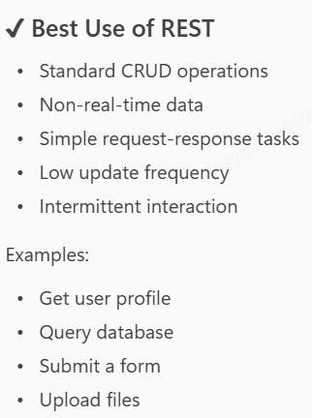
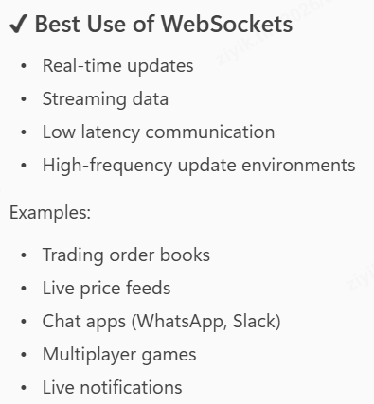
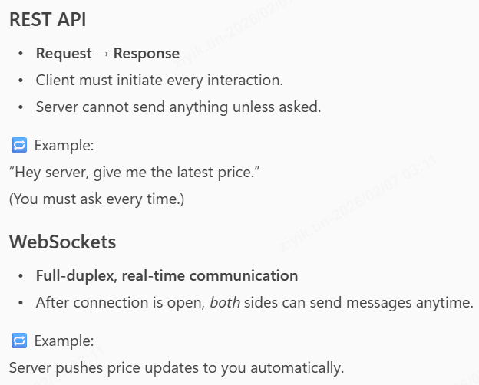
Websockets VS Rest APIs

Slide 11
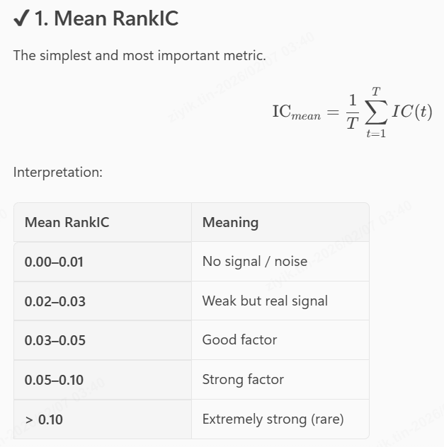
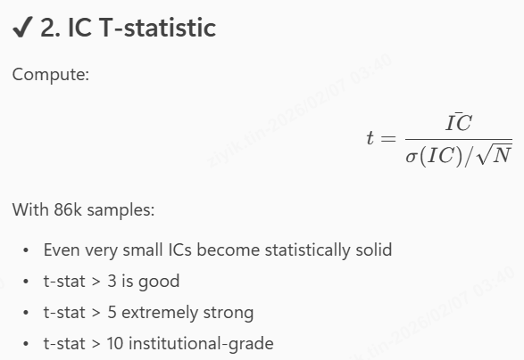
Given RankIC, how to know whether it is a good factor

Slide 12
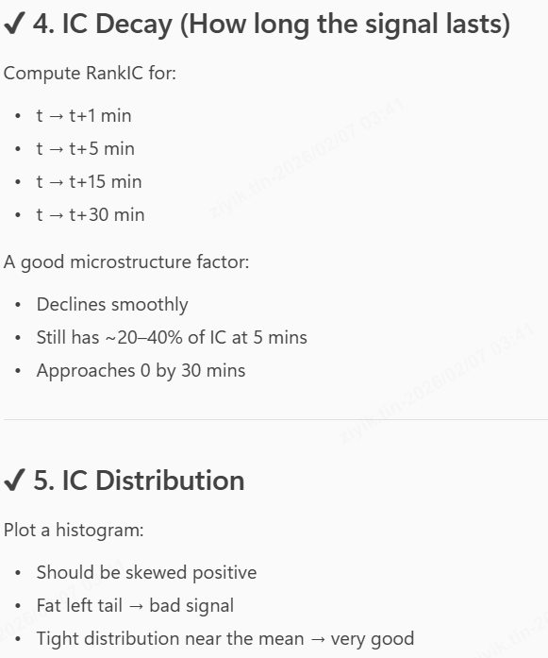
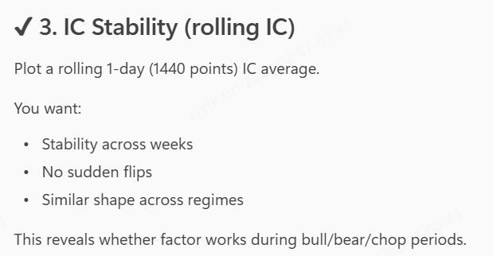
Given RankIC, how to know whether it is a good factor

Slide 13
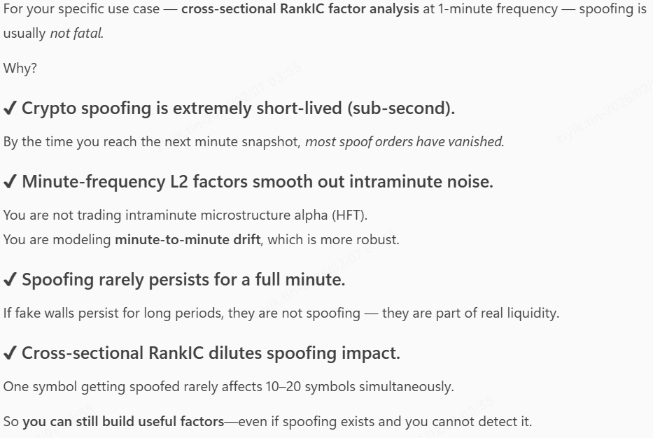
Don’t have to worry about spoofing

Slide 14
ORDER FLOW FACTORS
Lists of Order Flow Factors proven useful

Slide 15
Lists of Order Flow Factors proven useful
Rank | Factor Name | Type | Data Needed | What it Predicts | The "Alpha" (Signal)
1 | Order Book Imbalance (OBI) | Static (State) | L2 (Best) or L1 | Directional Pressure | Supply/Demand Ratio: High Bid volume vs. Ask volume pushes price UP. (Path of least resistance).
2 | Aggressor Ratio | Trade-Only | Trades Only | Momentum & Exhaustion | Taker Sentiment: Who is "hitting" the book harder? Buyers or Sellers? (Actual execution).
3 | Microprice Deviation | Static (State) | L1 (BBO) Only | Mean Reversion / Fair Value | True Price: Adjusts the mid-price based on volume weighting. Detects mispricing before it corrects.
4 | LOBSTER (OFI) | Dynamic (Flow) | L2 (Incremental) | Net Order Flow Intent | The Grand Unifier: Combines Limit Orders + Cancellations + Trades into one "Net Pressure" number.
5 | Replenishment Rate | Dynamic (Flow) | L1/L2 + Trades | Hidden Support/Resistance | Iceberg Detection: "The wall was eaten, but it grew back." Predicts reversals at key levels.
6 | Liquidity Depletion | Dynamic (Flow) | L2 (Incremental) | Spoofing / Breakouts | The Rug Pull: "The wall wasn't eaten; it just vanished." Predicts fake support/resistance failing.
7 | Depth Slope | Static (State) | L2 (Full Book) | Volatility / Impact | Elasticity: How steep is the book? Steep = Stable; Flat = Volatile/Fragile.

Slide 16
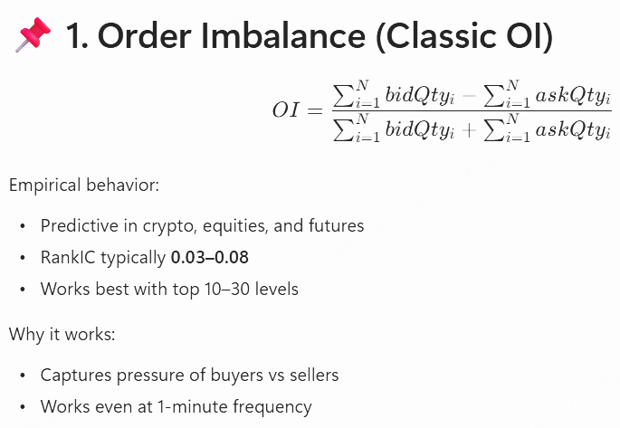
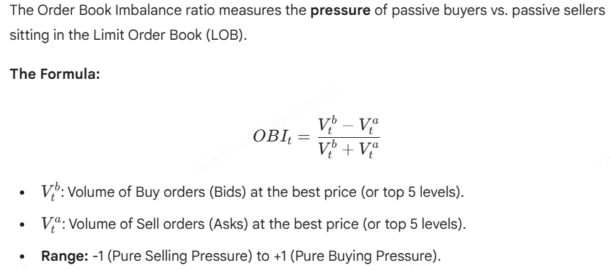
1. Order Book Imbalance Ratio (L1)

Slide 17
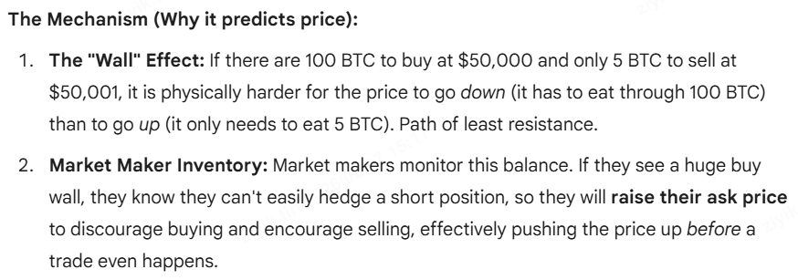
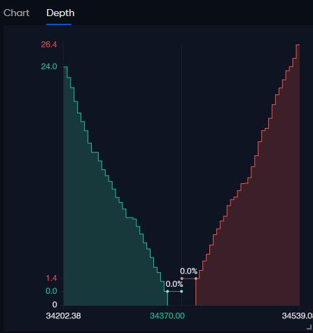
1. Order Book Imbalance Ratio
*Recall that ask price is the purchase price
Useful Link: 1. https://arxiv.org/pdf/2112.13213v1
2. https://www.researchgate.net/publication/47860140_The_Price_Impact_of_Order_Book_Events

Slide 18
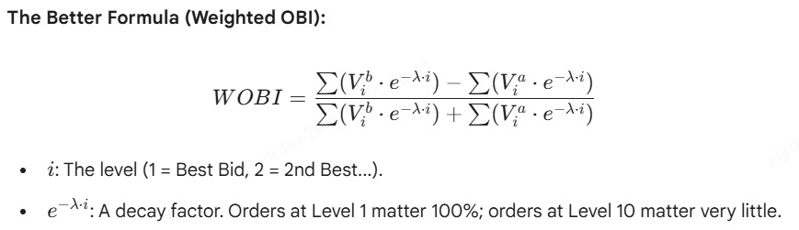
1. Order Book Imbalance Ratio
Standard OBI has a weakness: Spoofing
Solution: Depth Weighting.
Don't just sum the volume. Give more weight to orders close to the spread and less weight to orders far away.
Modified Formula:

Slide 19
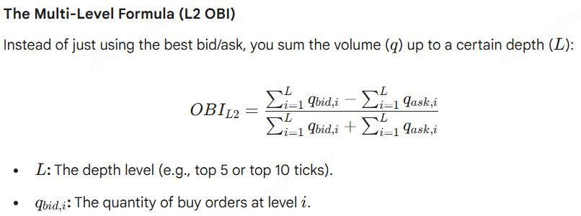
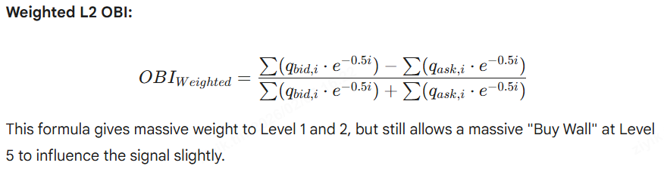
1. Order Book Imbalance Ratio (L2)

Slide 20
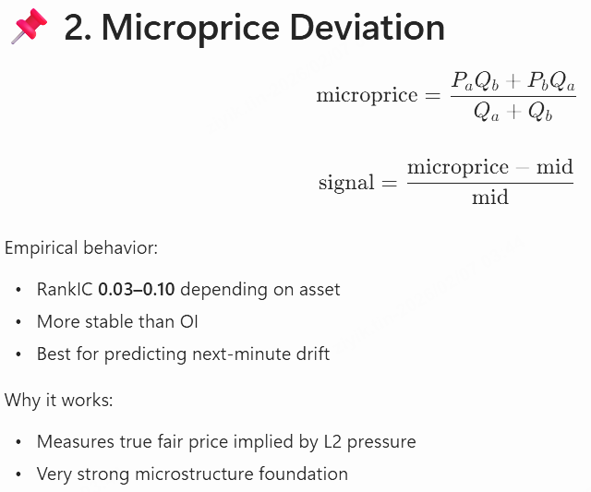
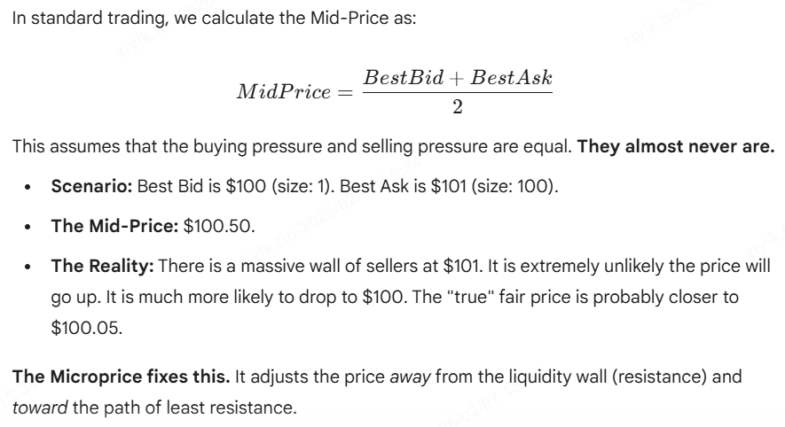
2. Microprice Deviation

Slide 21
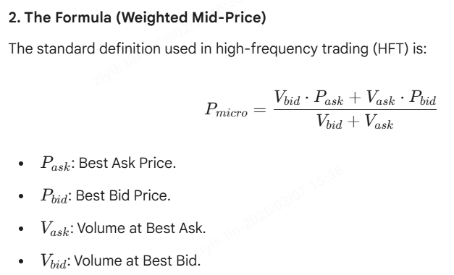
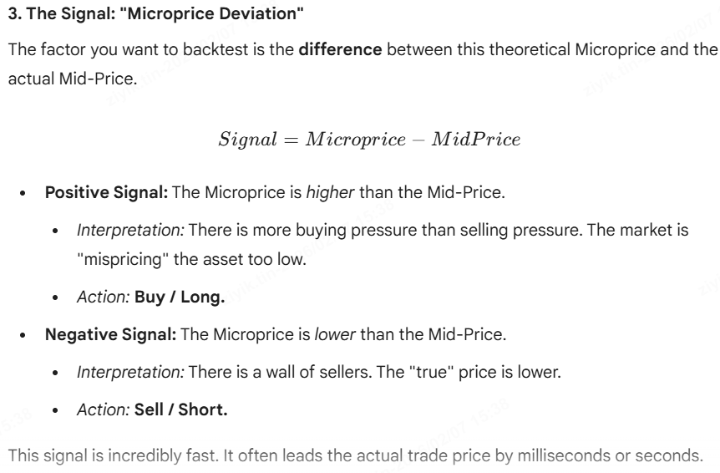
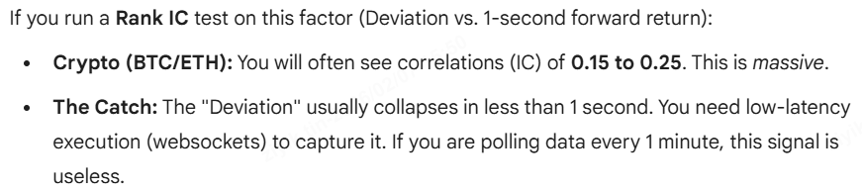
2. Microprice Deviation

Slide 22
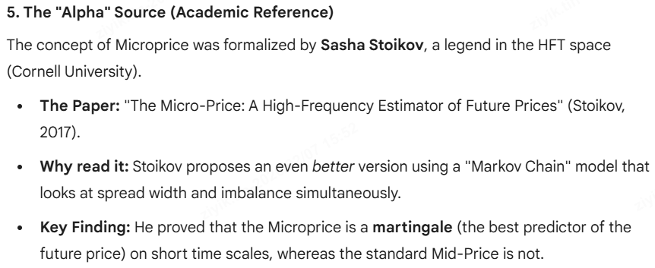
2. Microprice Deviation (optional)

Slide 23
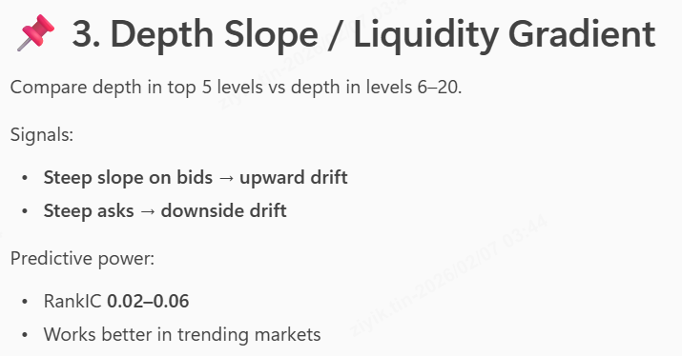
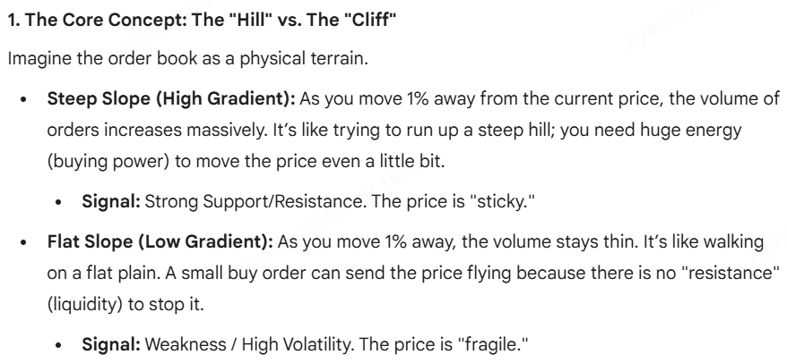
3. Depth Slope (Involve L2 Data)

Slide 24
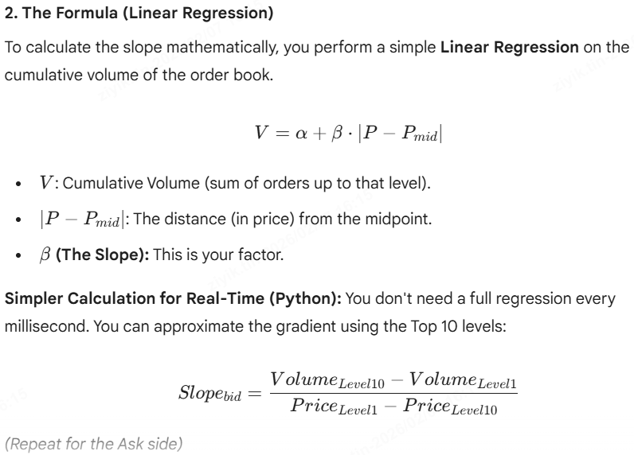
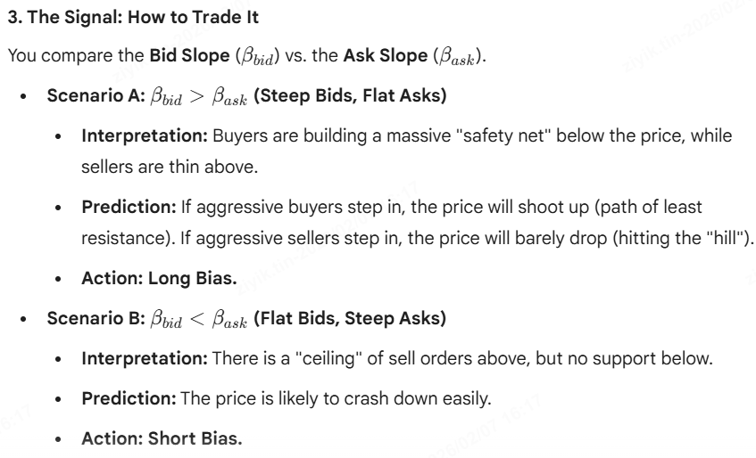
3. Depth Slope (Involve L2 Data)

Slide 25
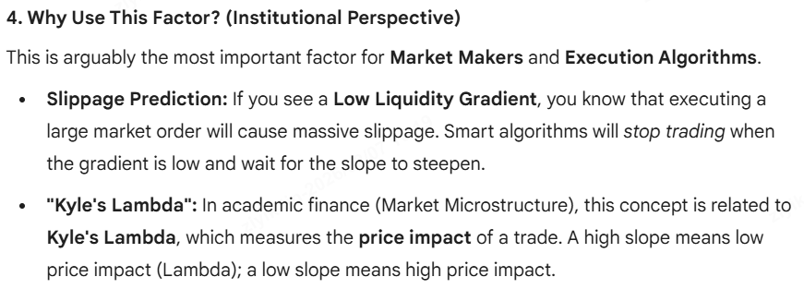
3. Depth Slope (Involve L2 Data)

Slide 26
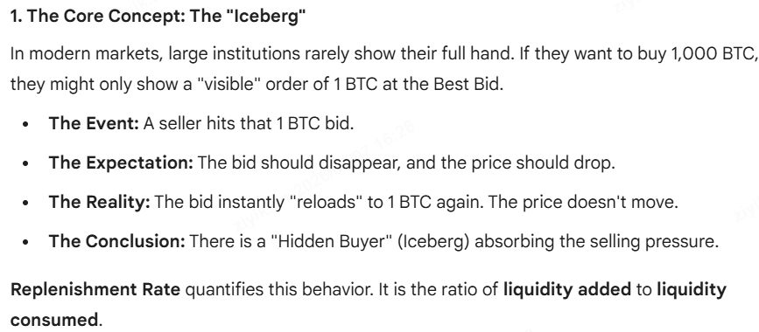
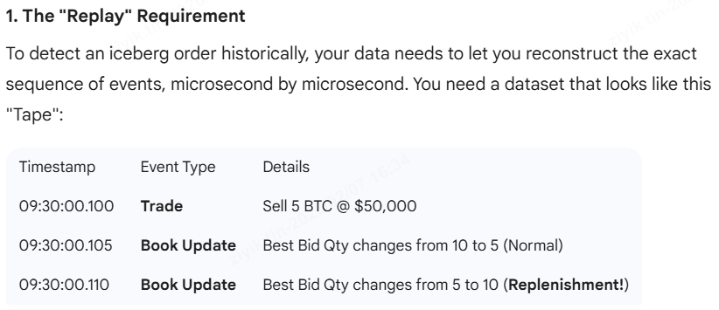
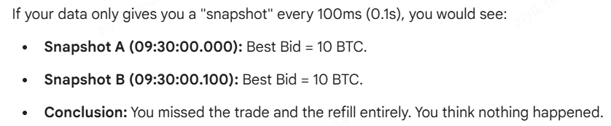
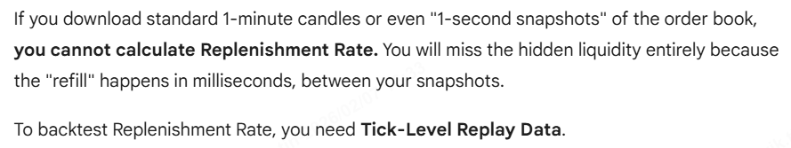
4. Replenishment Rate/Iceberg Detection

Slide 27
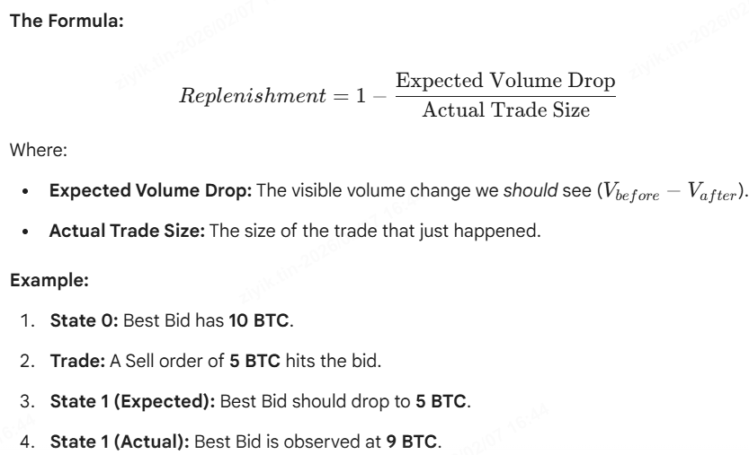
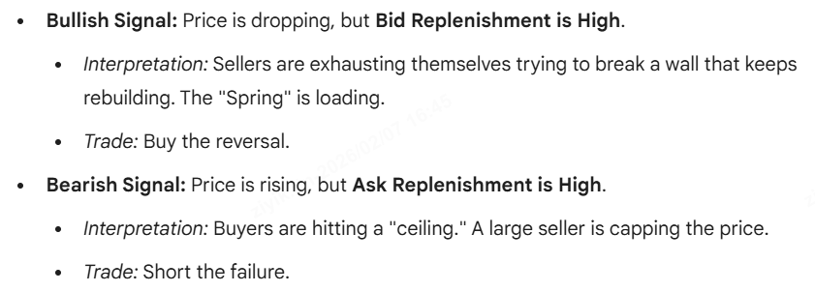
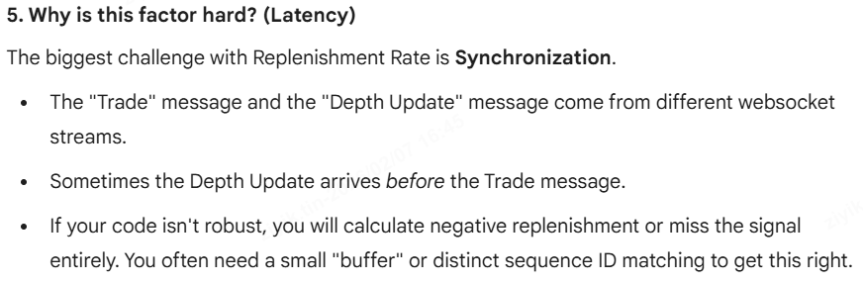
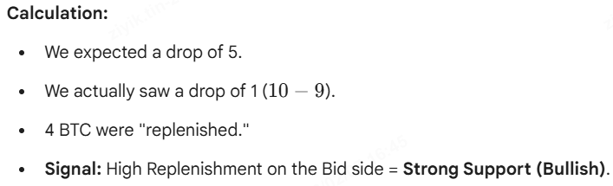
4. Replenishment Rate/Iceberg Detection

Slide 28


5. Aggressor Ratio/ Trade Flow Imbalance
While Order Imbalance (OBI) looks at the intent to trade (limit orders), the Aggressor Ratio looks at actual executed trades.
It tells you who is more desperate to trade right now: the buyers or the sellers.

Slide 29

5. Aggressor Ratio/ Trade Flow Imbalance
Like RSI
Don’t need L2

Slide 30


6. L2 Liquidity Depletion Indicator
To detect spoofing

Slide 31


6. L2 Liquidity Depletion Indicator

Slide 32



7. Order Flow Imbalance/LOBSTER factor
Most Important Factor

Slide 33


7. Order Flow Imbalance/LOBSTER factor
Most Important Factor

Slide 34


Other Advanced L2 Level Factors
…

Slide 35




Other Advanced L2 Level Factors
…

Slide 36


Optional: L3 Level Factors
…

Slide 37


Optional: L3 Level Factors
…

Slide 38


Optional: L3 Level Factors
…

